Slide 1


VCS and Git
itechart.com

Slide 2
Why do we need VCS?
• Rollback of incorrect changes
• Clarifying the reasons for the change
• Support for multiple product versions
• Data recovery in case of equipment damage
• Teamwork
• Ability to see changes for a specific task
• Code review

Slide 3
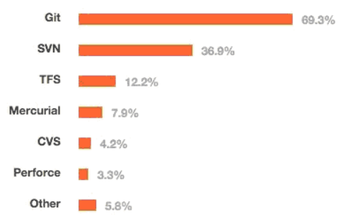
Types
• Local (RCS)
• Centralized (CVS, SVN, Perforce)
• Distributed (Git, Mercurial, Bazaar, Darcs)

Slide 4
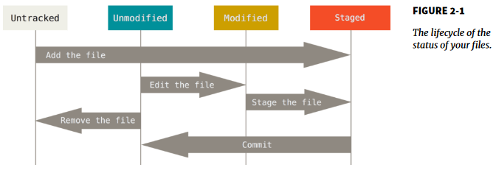
Simple Git Flow
• git init
• git add
• git commit
• git status
• git log
• git <command> --help

Slide 5
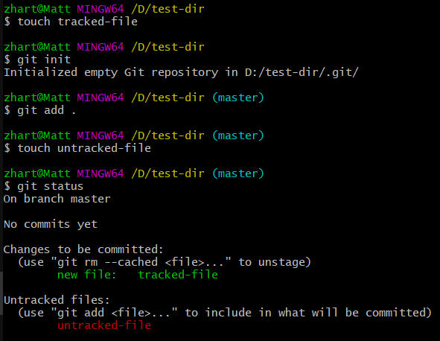

Slide 6
Changes cancelling
• git checkout <hash or branch>
• git reset <hash> [--soft, --mixed, --hard]
• git revert <hash>

Slide 7
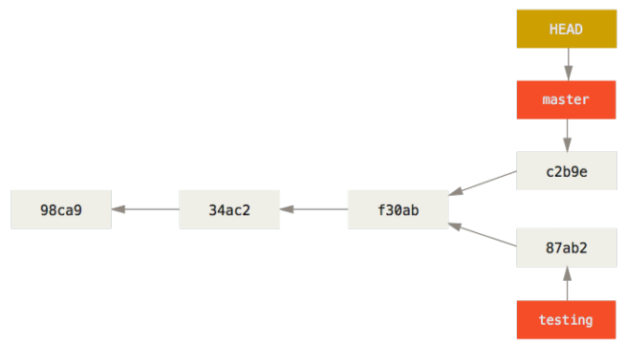
Branches
• git branch <name>
• git checkout <branch>
• git merge <branch>
• git rebase <branch>

Slide 8
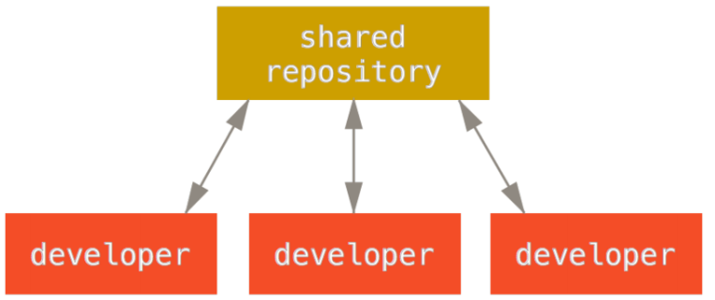
Remote Repository
• git clone
• git fetch
• git push
• git pull (fetch + merge)
• git remote add origin <url>

Slide 9
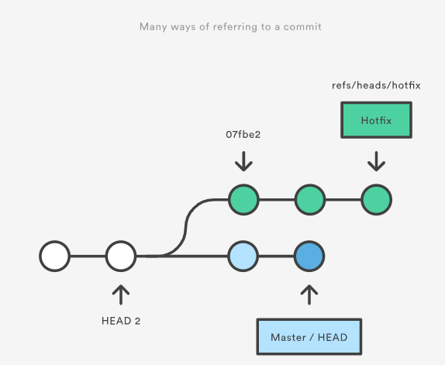
Refs
• Hash
• Branch
• Tag
• HEAD
• etc.

Slide 10
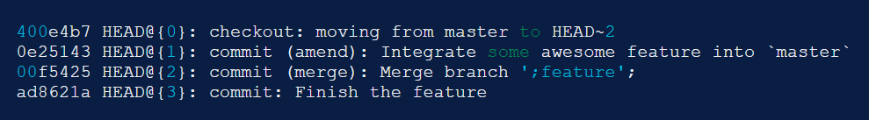
References log
• git reflog
The reflog is Git’s safety net.
Chronological history of everything you’ve done in your local repo.

Slide 11
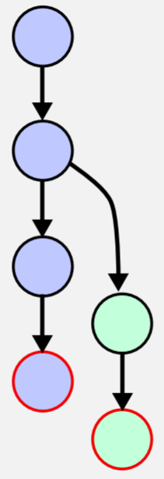
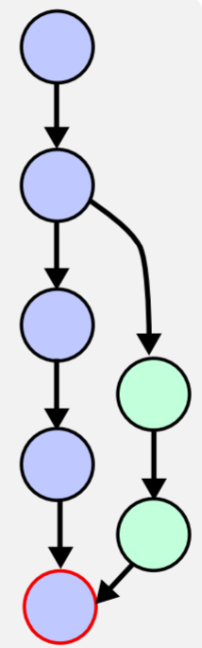
Merge

Slide 12
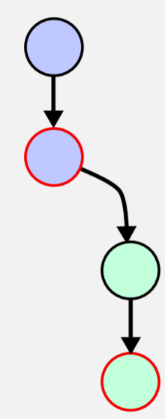
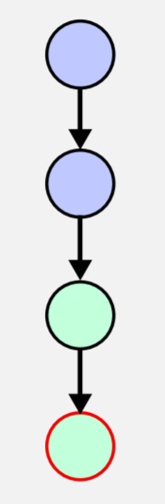
Fast Forward

Slide 13
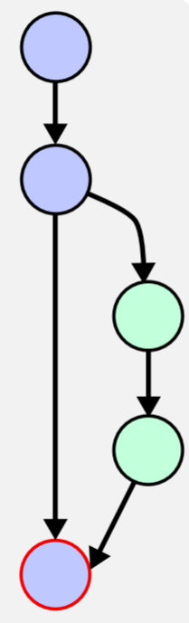
No Fast Forward (--no-ff)

Slide 14
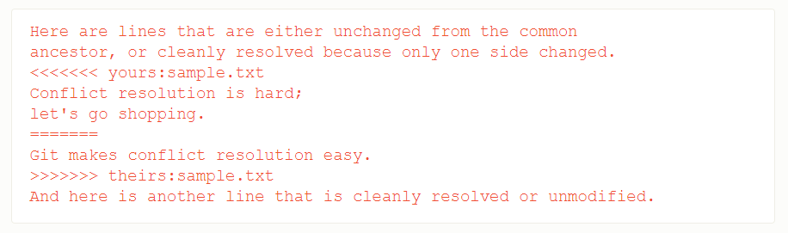
Merge Conflicts
• Edit conflicted files
• Add them to index
• Commit
• git add
• git commit
• git merge --continue

Slide 15
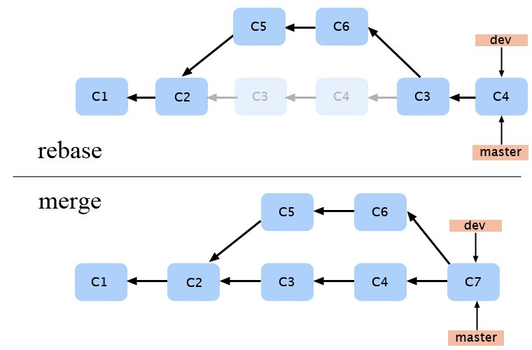
Rebase
• git rebase
• git rebase –onto <base>
• git push -- force

Slide 16
Rewriting History
• git stash
• git commit --ammend
• git rebase –interactive HEAD

Slide 17
.gitignore
• Blank lines or lines starting with # are ignored.
• Standard glob patterns work.
• You can start patterns with a forward slash (/) to avoid recursivity.
• You can end patterns with a forward slash (/) to specify a directory.
• You can negate a pattern by starting it with an exclamation point (!).

Slide 18
.gitignore
• An asterisk (*) - zero or more characters.
• A question mark (?) - a single character
• [abc] - any character inside the brackets
• [0-9] - any character from range
• Two asterisks (**) - nested directories

Slide 19
.gitignore
• 1. --system (C:/ProgramData/Git/.config)
• 2. --global (C:/Users/$USER/.gitconfig)
• 3. config file in the Git directory (.git/config)
• git config --global user.name "John Doe"
• git config --global user.email johndoe@example.com

Slide 20
.gitignore
• core.autocrlf
true checkout Windows-style, commit Unix-style
input checkout as-is, commit Unix-style
false checkout as-is, commit as-is
• credential.helper
feature to avoid inputting git credentials repeatedly

Slide 21
Git Hooks
• client side (pre-commit, post-commit, pre-push, etc.)
• server side (pre-receive, update, post-receive)

Slide 22
Git Workflow
2023
itechart.com

Slide 23
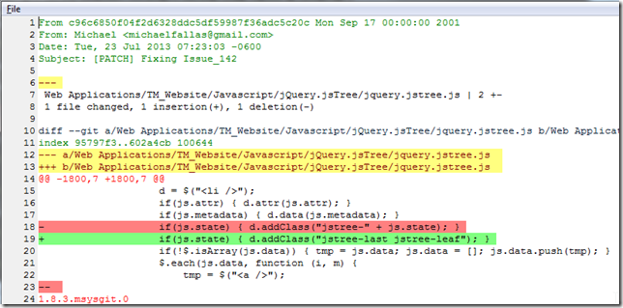
Patch

Slide 24
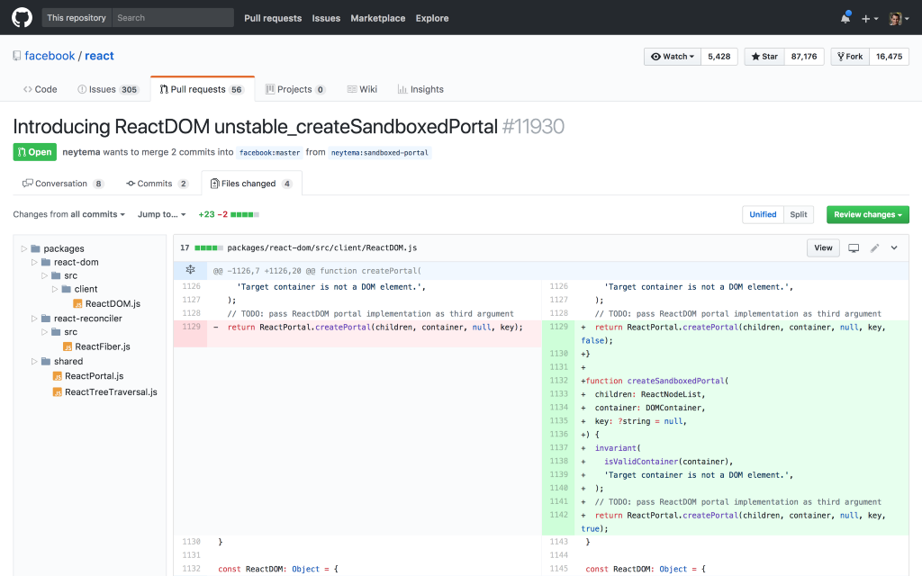
Pull Request
• Notify team
• Discuss and propose
• Collect issues

Slide 25
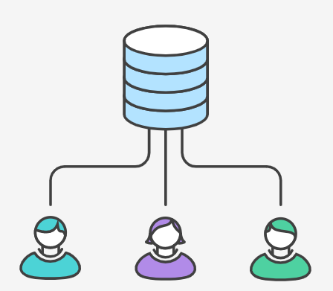
Centrilized Workflow
• Central repository is a single point-of-entry for all changes to the project.
• Each developer work independently of all other changes to a project, but all changes are pushed into the single branch master.

Slide 26
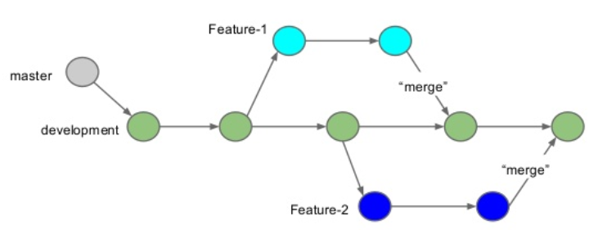
Feature Branch Workflow
All feature development should take place in a dedicated branch.
• Encapsulates features
• Master only contains tested code
• PRs

Slide 27

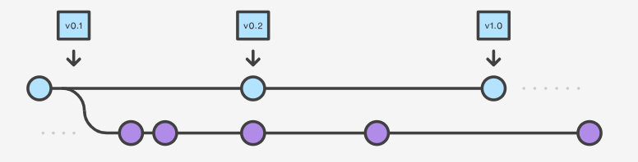
Gitflow Workflow
• Gitflow is ideally suited for projects that have a scheduled release cycle.
• In addition to feature branches, it uses individual branches for preparing, maintaining, and recording releases.

Slide 28
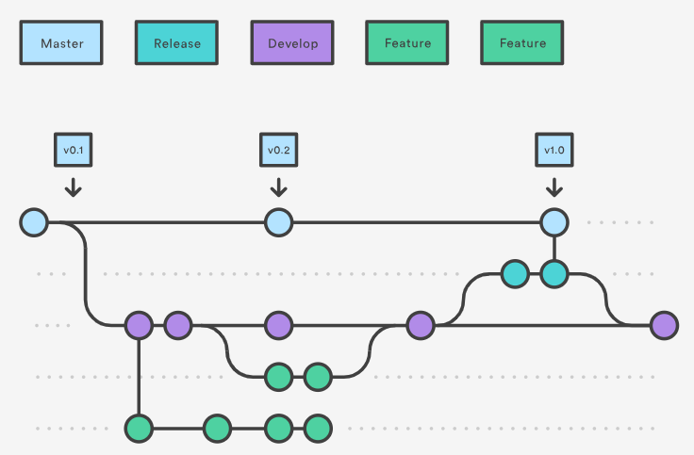
Gitflow Workflow

Slide 29
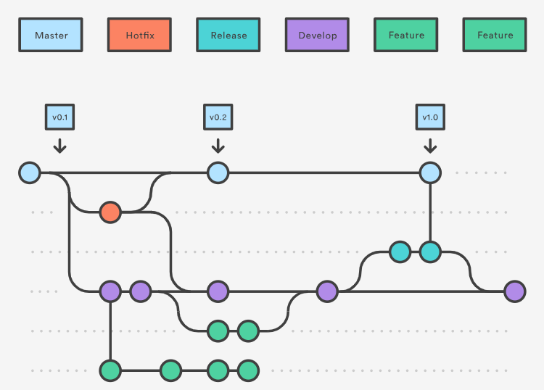
Hotfix Branches

Slide 30

Forking Workflow
• It gives every developer their own server-side repository.
• Forked repositories are created using git clone.
• It is most often seen in public open-source projects.

Slide 31

Thank you!
itechart.com

